Slide 1
Instructions
Thank you for downloading this PowerPoint.
The design, style, and all included images are copyright to CCCU-UK/SCIO 2018. The images are not to be copied and used elsewhere without prior permission.
With that proviso, please feel free to use this PowerPoint as you wish: delete slides, add others, add your own pictures. This is being made available to make it easier for you to set something up, and not to restrict what you would like to say.
If you do use these slides, our expectation is that the slide will prompt you to talk about your thoughts on whatever the slide is on.
Please be aware that there are a few slides that includes text for you to add something of your own, so don’t forget to edit those bits!

Slide 3
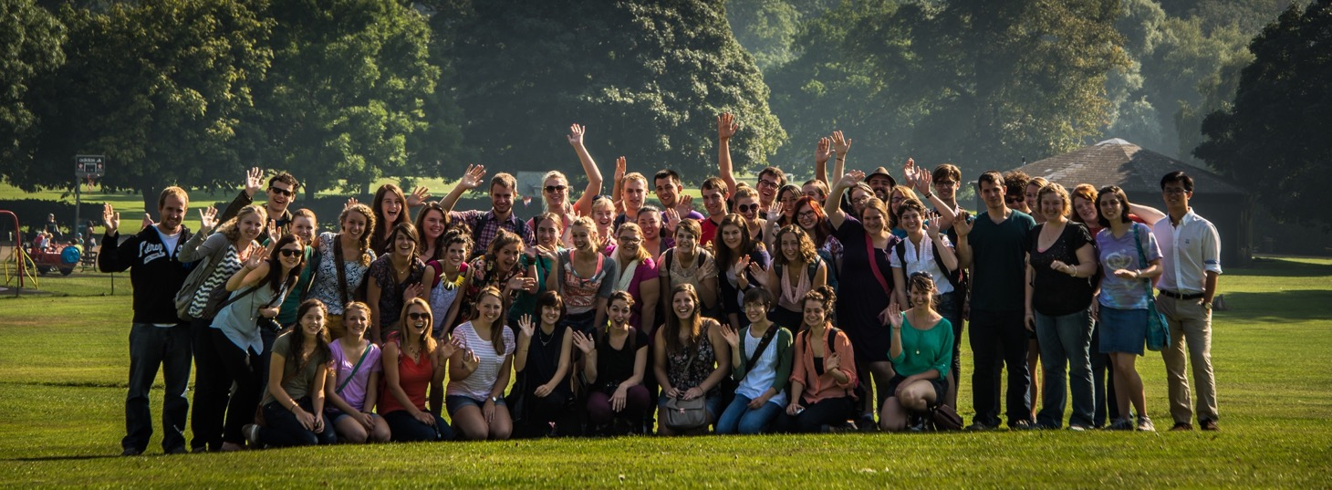
Scholars’ Semester in Oxford (SSO)
[Add your term and year]
Michaelmas Term, Hilary Term

Slide 4
The city of Oxford
Oxford is a vibrant place with many other international students
Plenty to see and do in this beautiful city
[Add how you found the city as a place to live]

Slide 5
Wycliffe Hall
Everyone in SSO is a Registered Visiting student with the University
Everyone in SSO is a member of Wycliffe Hall
This status gives access to University lectures, libraries, and all the social clubs and sport teams

Slide 6
The University of Oxford
One of the most prestigious universities in the world
made up of 45 colleges and halls, including Wycliffe Hall
[Your impressions]

Slide 7
The University’s Bodleian library
Over 12 million books, and growing every year
There are about 120 other libraries within the University of Oxford
[your thoughts/ favourite study spots]

Slide 8
Humanities and social sciences
Disciplines available for SSO in …
classics
English language and literature
gender studies
history
history of art
history of science
musicology
philosophy
political science
psychology
theology

Slide 9
From 2018: STEM
Disciplines available for SSO in …
biological sciences
chemistry
earth sciences
mathematics
physics
statistics
theoretical computer science

Slide 10
Tutorials
One-on-one meetings with a tutor over eight weeks
The primary tutorial meets every week
The secondary tutorial meets every other week
[What was it like?]

Slide 11
British culture programme
Explores Oxford and places such as Stonehenge, Bath, and London
[Add how you found the trips]

Slide 12
Undergraduate Research Seminar
The seminars are divided by discipline and meet five times, plus lectures
Seminars discuss the integration of Christian belief with the discipline
With the help of a personal supervisor, everyone develops a question and answers it in a research paper

Slide 13
Vocation and scholarship
Weekly talks followed by afternoon tea
Examines the idea of vocation
Includes sessions on career development and graduate studies

Slide 14
University of Oxford : Faith
Many ways to engage and develop Christian faith …
SCIO programmes explore connections between academics and faith
College chapels
Many active Oxford churches
Many Christian clubs to join

Slide 15
University of Oxford : Sport
Many sports to join, including …
Football (soccer)
Rowing
Tennis
Fencing
Ultimate Frisbee
Lacrosse
Tiddlywinks
… and much more!

Slide 16
University of Oxford : Clubs
Hundreds of clubs and societies to join, including …
C.S. Lewis Society
Debating
Film clubs
Creative writing
Numismatics
Foreign language
Caving / hiking
… and much more!

Slide 17
Accommodation
Most students live at The Vines, a large Victorian villa with views over Oxford. Free bikes are provided for people at the Vines.
Some students live in the North Wing at Wycliffe Hall. These dormitory-style rooms are closer to the city centre.

Slide 18
Afternoon tea
Tea is the country’s national drink
Tea is provided regularly during the programme
[your thoughts!]

Slide 19
Returning for a second semester
Every year, some students come for a second semester
It allows you to get even more out of Oxford
Returning students work on a thesis, a longer research document that is written under the guidance of a supervisor

Slide 20
Visiting other places: UK
Very easy to get to London from Oxford
Lots of wonderful places to get to by public transport
[Add something about places you or your friends visited]

Slide 21
Visiting other places: Europe
Mid-term break provides a good time to travel further afield
[Add something about places you or your friends visited]

Slide 22
Come to Oxford as well!
GPA 3.7 or higher to apply
www.scio-uk.org
wycliffehall.org.uk
Apply via BestSemester: bestsemester.com/sso

